Slide 1
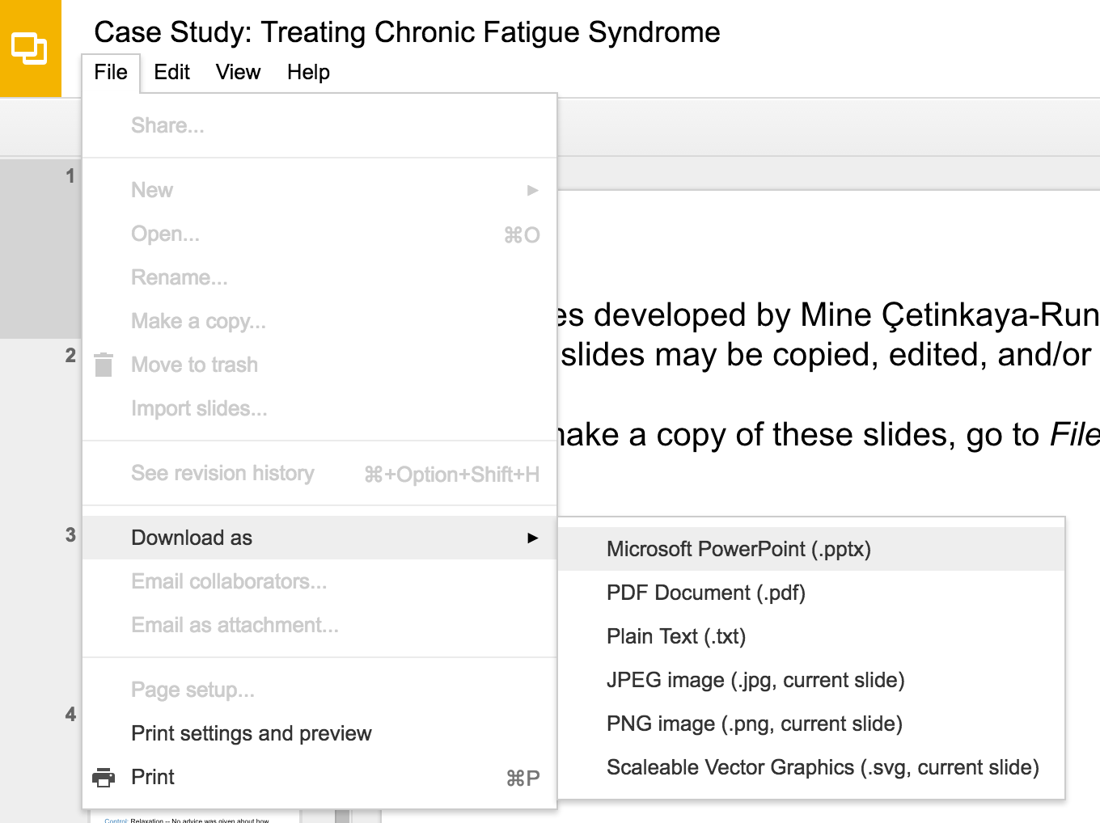
Slides developed by Mine Çetinkaya-Rundel of OpenIntro
Translated from LaTeX to Google Slides by Curry W. Hilton of OpenIntro.
The slides may be copied, edited, and/or shared via the CC BY-SA license
To make a copy of these slides, go to File > Download as > [option], as shown below. Or if you are logged into a Google account, you can choose Make a copy... to create your own version in Google Drive.

Slide 2
Model selection

Slide 3
Beauty in the classroom
Data: Student evaluations of instructors’ beauty and teaching quality for 463 courses at the University of Texas.
Evaluations conducted at the end of semester, and the beauty judgements were made later, by six students who had not attended the classes and were not aware of the course evaluations (2 upper level females, 2 upper level males, one lower level female, one lower level male).
Hamermesh & Parker. (2004)“Beauty in the classroom: instructorsO˜ pulchritude and putative pedagogical productivityO´
Economics Education Review.

Slide 4
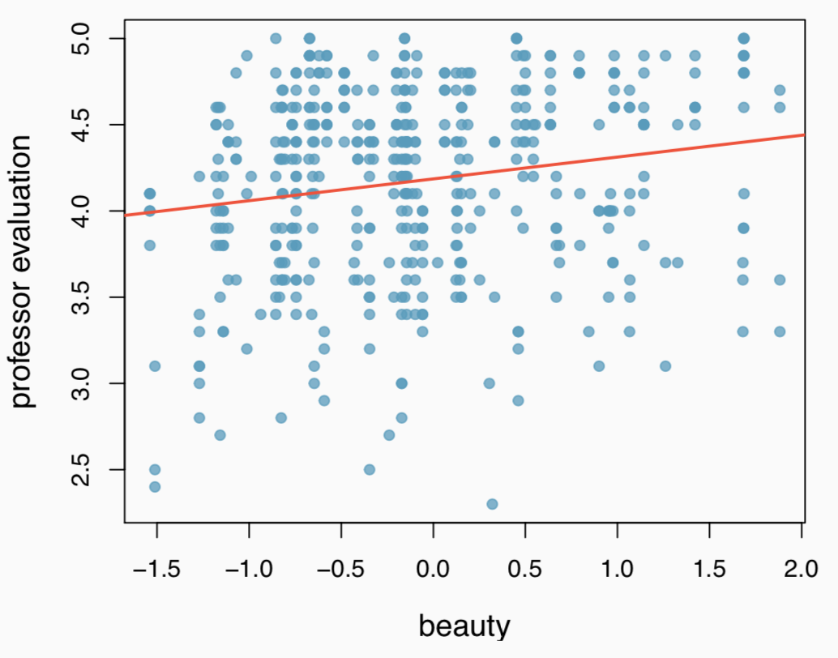
Professor rating vs. beauty
Professor evaluation score (higher score means better) vs. beauty score (a score of 0 means average, negative score means below average, and a positive score above average):
27

Slide 5
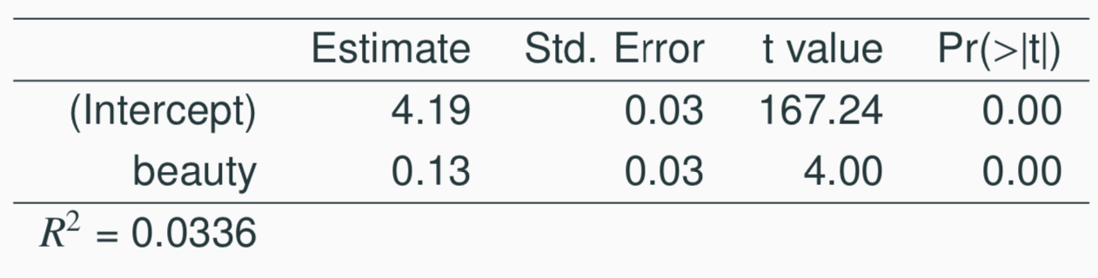
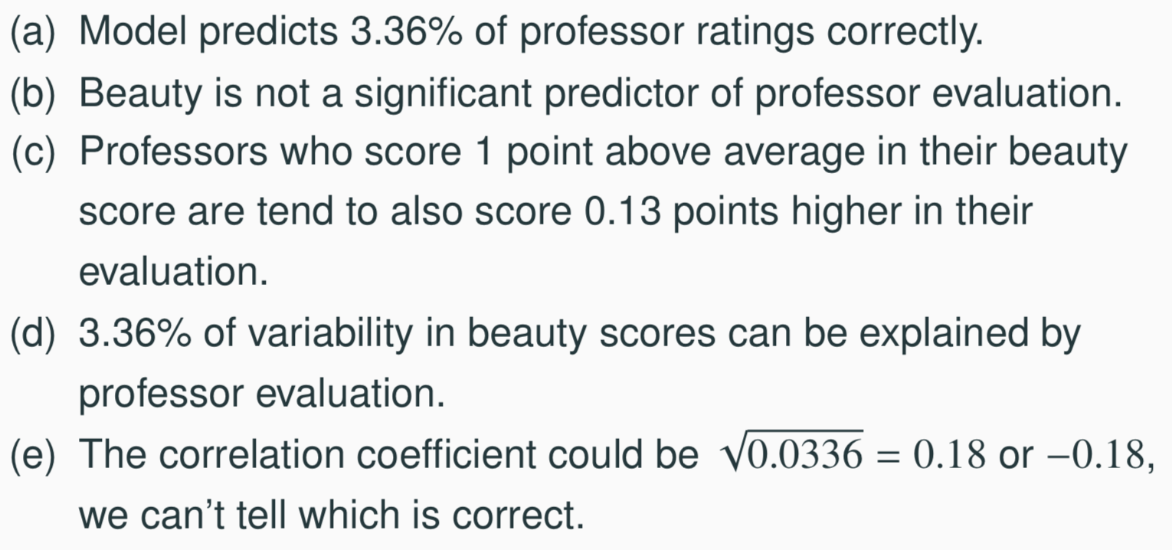
Which of the below is correct based on the model output?
33

Slide 6
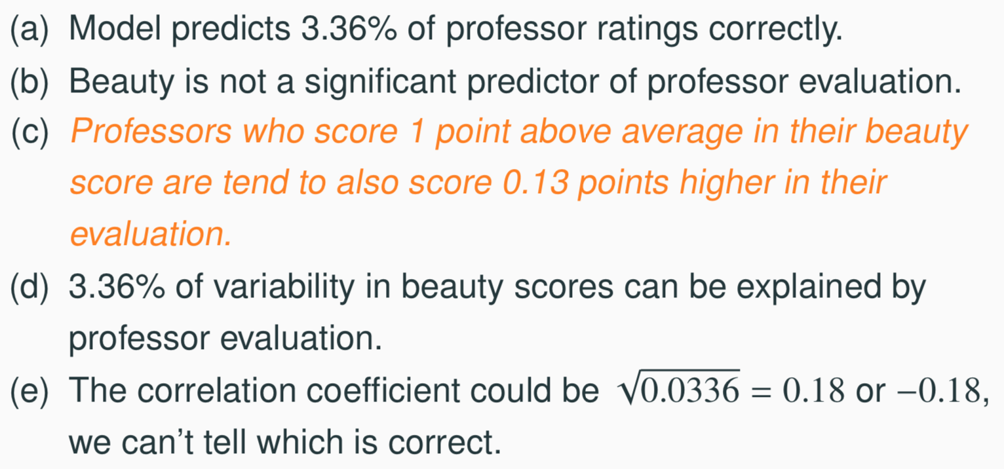
Which of the below is correct based on the model output?
33

Slide 7
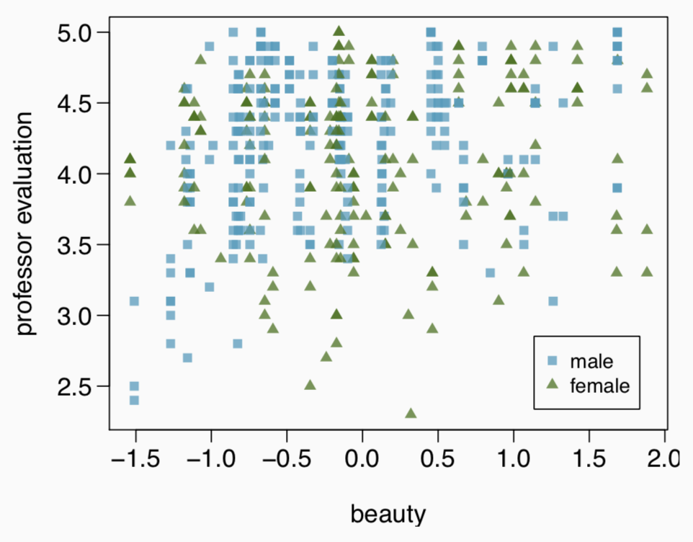
Exploratory analysis
Any interesting features?
For a given beauty score, are male professors evaluated higher, lower, or about the same as female professors?
27

Slide 8
Exploratory analysis
Any interesting features?
Few females with very low beauty scores.
For a given beauty score, are male professors evaluated higher, lower, or about the same as female professors?
27

Slide 9
Exploratory analysis
Any interesting features?
Few females with very low beauty scores.
For a given beauty score, are male professors evaluated higher, lower, or about the same as female professors?
Few females with very low beauty scores.
27

Slide 10
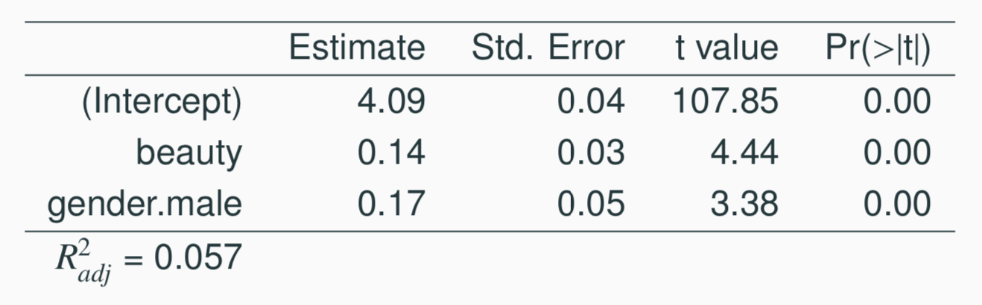
Professor rating vs. beauty + gender
For a given beauty score, are male professors evaluated higher, lower, or about the same as female professors?
(a) higher
(b) lower
(c) about the same
27

Slide 11
Professor rating vs. beauty + gender
For a given beauty score, are male professors evaluated higher, lower, or about the same as female professors?
(a) higher → Beauty held constant, male professors are rated
0.17 points higher on average than female professors.
(b) lower
(c) about the same
27

Slide 12
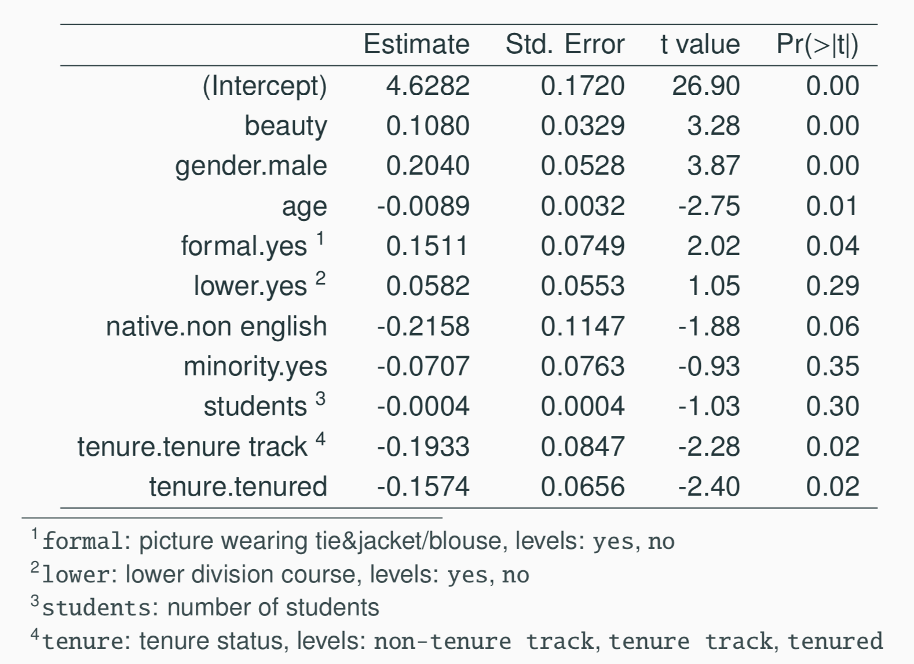
Full Model
27

Slide 13
Hypotheses
Just as the interpretation of the slope parameters take into account all other variables in the model, the hypotheses for testing for significance of a predictor also takes into account all other variables.
H₀: B_{i} = 0 when other explanatory variables are included in the model.
H_{A}: B_{i} ≠ 0 when other explanatory variables are included in the model.
27

Slide 14
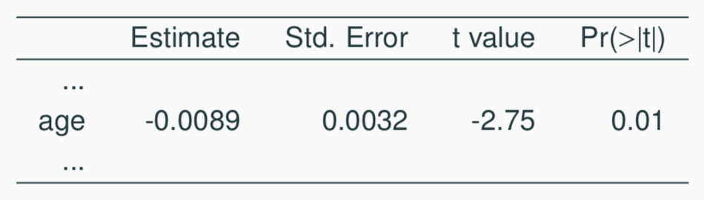
Assessing significance: numerical variables
The p-value for age is 0.01. What does this indicate?
Since p-value is positive, higher the professor’s age, the higher we would expect them to be rated.
If we keep all other variables in the model, there is strong evidence that professor’s age is associated with their rating.
Probability that the true slope parameter for age is 0 is 0.01.
There is about 1% chance that the true slope parameter for age is -0.0089.
27

Slide 15
Assessing significance: numerical variables
The p-value for age is 0.01. What does this indicate?
Since p-value is positive, higher the professor’s age, the higher we would expect them to be rated.
If we keep all other variables in the model, there is strong evidence that professor’s age is associated with their rating.
Probability that the true slope parameter for age is 0 is 0.01.
There is about 1% chance that the true slope parameter for age is -0.0089.
27

Slide 16
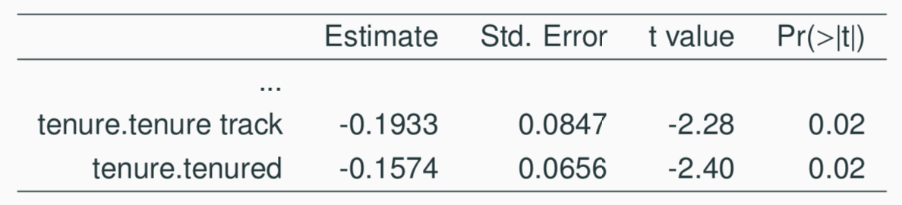
Assessing significance: categorical variables
Tenure is a categorical variable with 3 levels: non tenure track, tenure track, tenured. Based on the model output given, which of the below is false?
Reference level is non tenure track.
All else being equal, tenure track professors are rated, on average, 0.19 points lower than non-tenure track professors.
All else being equal, tenured professors are rated, on average, 0.16 points lower than non-tenure track professors.
All else being equal, there is a significant difference between the average ratings of tenure track and tenured professors.
27

Slide 17
Assessing significance: categorical variables
Tenure is a categorical variable with 3 levels: non tenure track, tenure track, tenured. Based on the model output given, which of the below is false?
Reference level is non tenure track.
All else being equal, tenure track professors are rated, on average, 0.19 points lower than non-tenure track professors.
All else being equal, tenured professors are rated, on average, 0.16 points lower than non-tenure track professors.
All else being equal, there is a significant difference between the average ratings of tenure track and tenured professors.
27

Slide 18
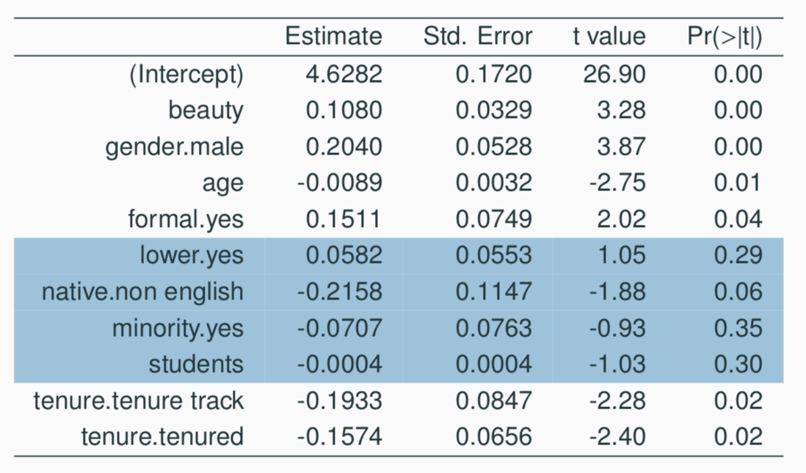
Assessing significance
Which predictors do not seem to meaningfully contribute to the model, i.e. may not be significant predictors of professor’s rating score?

Slide 19
Model selection strategies
Based on what we’ve learned so far, what are some ways you can think of that can be used to determine which variables to keep in the model and which to leave out?

Slide 20
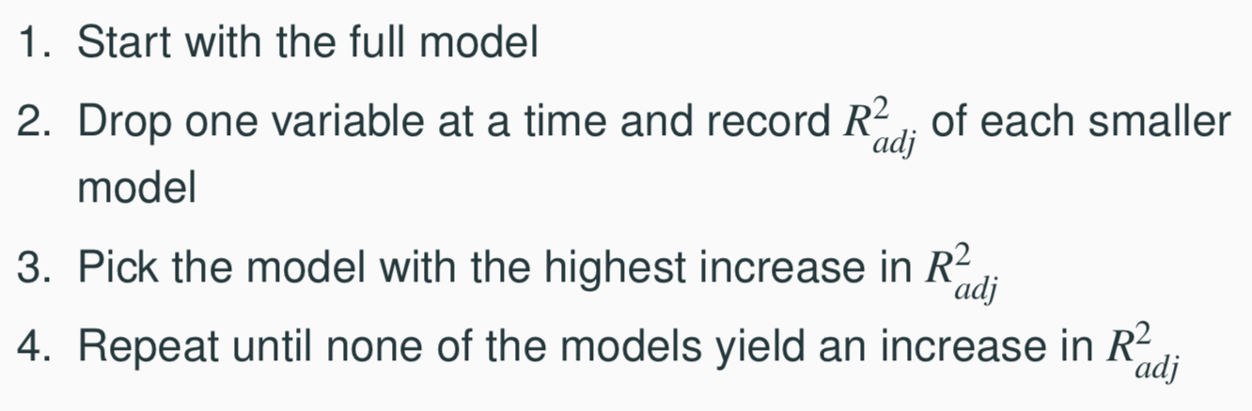
Backward-elimination
27

Slide 21
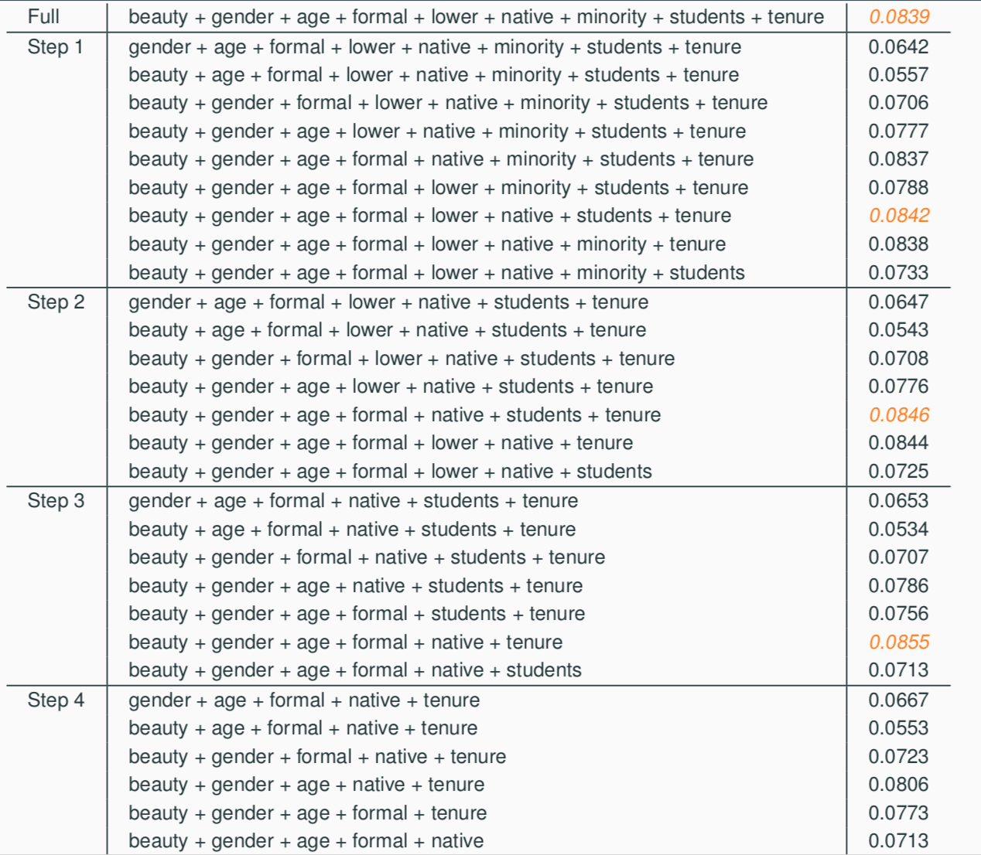
Backward-elimination
27

Slide 22
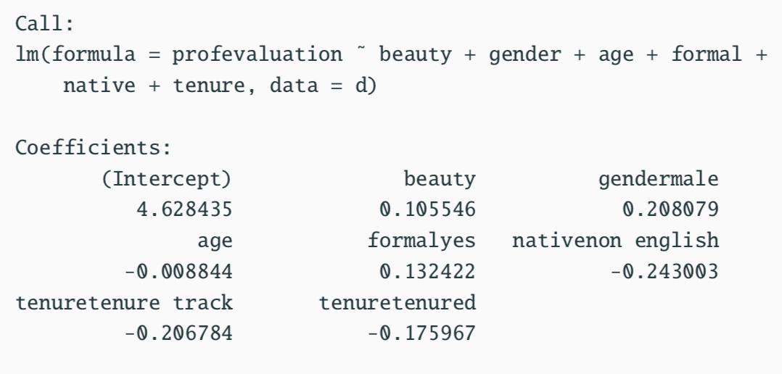
step function in R
The step function in R does a similar backward elimination process, however it uses a different metric called AIC (Akaike Information Criterion) instead of adjusted R² to do the model selection.
Best model: beauty + gender + age + formal + native + tenure
27

Slide 23
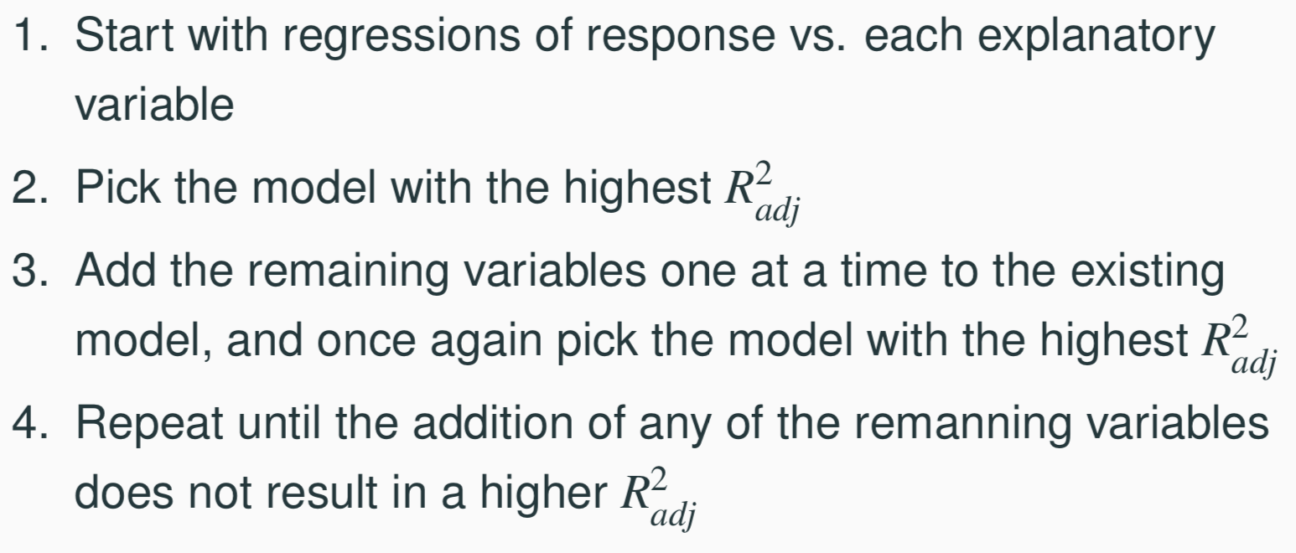
Forward-selection
27

Slide 24
Backward-Elimination vs. Forward-Selection
Backward elimination with the p-value approach:
Start with the full model
Drop the variable with the highest p-value and refit a smaller model
Repeat until all variables left in the model are significant
Backward elimination with the p-value approach:
Start with regressions of response vs. each explanatory variable
Pick the variable with the lowest significant p-value
Add the remaining variables one at a time to the existing model, and pick the variable with the lowest significant p-value
Repeat until any of the remaining variables does not have a significant p-value
27

Slide 25
Adjusted R² vs. p-value approaches
The two approaches are similar, but they sometimes lead to different models, with the adjusted R2 approach tending to include more predictors in the final model.
When the sole goal is to improve prediction accuracy, use R2 . This is commonly the case in machine learning applications.
When we care about understanding which variables are statistically significant predictors of the response, or if there is interest in producing a simpler model at the potential cost of a little prediction accuracy, then the p-value approach is preferred.
Regardless of the approach we use, our job is not done after variable selection – we must still verify the model conditions are reasonable.
27

Slide 26
Find more resources at openintro.org/os, including
Slides
Videos
Statistical Software Labs
Discussion Forums (free support for students and teachers)
Learning Objectives
Teachers only content is also available for Verified Teachers, including
Exercise solutions
Sample exams
Ability to request a free desk copy for a course
Statistics Teachers email group
Questions? Contact us.

